Slide 1

Build a Personalized Online Course Recommender System with Machine Learning
<Sadegh Khajepour>
<2026/01/08>

Slide 2

Outline
Introduction and Background
Exploratory Data Analysis
Content-based Recommender System using Unsupervised Learning
Collaborative-filtering based Recommender System using Supervised learning
Conclusion
Appendix
2

Slide 3
Introduction
Project Background and Context:
In this project, we will be developing a content-based recommender system. A content-based recommender uses item features to recommend items similar to those the user has shown interest in. This type of system analyzes the attributes of items and suggests similar items based on the content they contain.
Problem Statement:
The goal is to build a content-based recommender system that effectively suggests relevant items to users based on their preferences. The challenge lies in selecting and implementing the right models to achieve optimal recommendations.
Hypotheses:
We hypothesize that different machine learning models, when applied to the task of content-based recommendation, will perform differently. Our objective is to test various models and identify the one that provides the most accurate and relevant recommendations for the users.
3

Slide 4



Exploratory Data Analysis

Slide 5
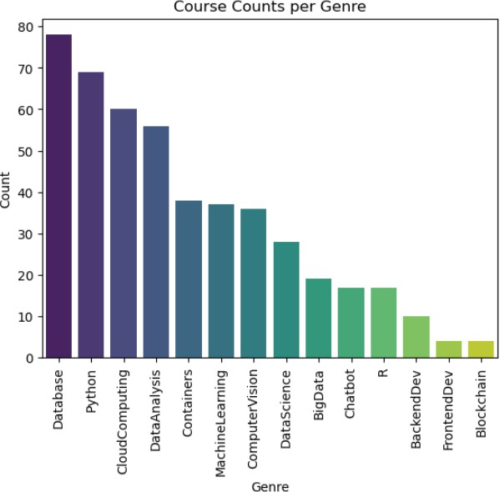
Course counts per genre
The bar chart shows the number of courses available for different genres in a learning platform.
Database leads with nearly 80 courses, indicating high demand or
interest.
Python and Cloud Computing follow with around 70 and 60 courses, respectively.
Data Analysis also has a significant presence.
Mid-tier categories like Machine Learning, Computer Vision, and
Data Science each have around 30–40 courses.
Genres like Big Data, Chatbot, and R have fewer courses, ranging between 10 and 20.
Blockchain, Frontend Development, and Backend Development have the fewest courses, suggesting less content or lower demand.
The distribution suggests a strong focus on data-related skills, especially databases and Python, while newer or niche fields like Blockchain have less content.

Slide 6
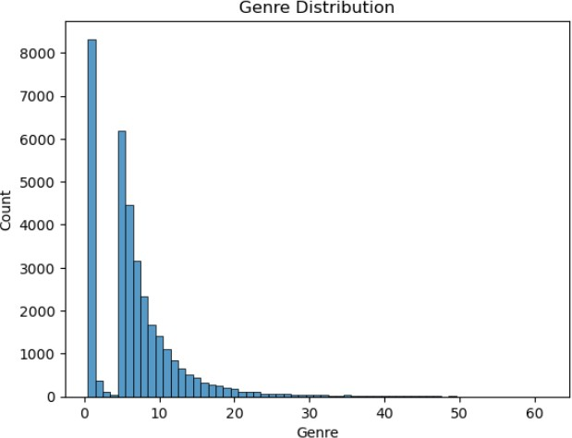
Course enrollment distribution
The distribution is highly skewed to the right (positive skew), with a few dominant genres having very high counts (over 8,000 for the most frequent genre) and a long tail of less common genres with decreasing frequencies. The majority of
in
content appears to be concentrated
genres numbered 0-15, with frequencies dropping significantly after that point.

Slide 7
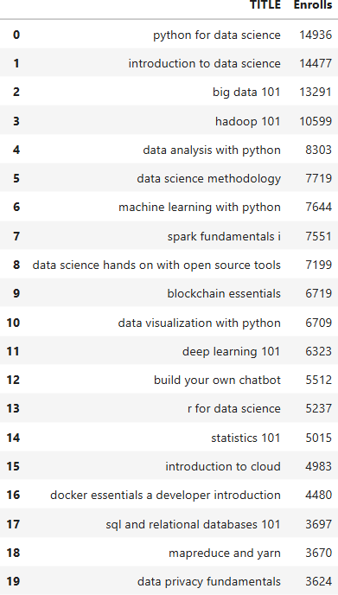
20 most popular courses
The courses primarily focus on data science, programming, and related technologies. Python-based courses dominate the top spots, with "Python for Data Science" having the highest enrollment at 14,936 students. The list demonstrates a strong interest in data science fundamentals, big data technologies, and machine learning, with enrollments gradually decreasing from around 15,000 for the most popular course to about 3,600 for the 20th ranked course.

Slide 8
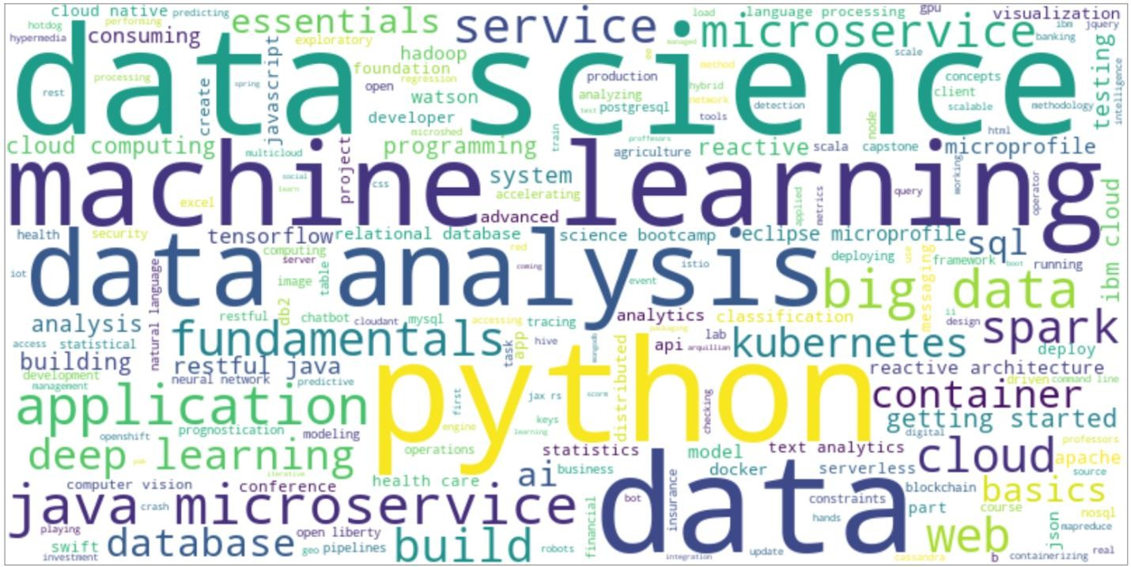
Word cloud of course titles
The largest terms are "python", "data", "machine learning", and "analysis", indicating these are the most frequently occurring
terms in course titles
Second-tier prominent terms include "service", "science", "java", "microservice", showing important technical and programming concepts
Supporting terms like "fundamentals", "cloud", "big data", "kubernetes", "spark" reflect the broader ecosystem of data science and cloud technologies

Slide 9
Content-based Recommender System using Unsupervised Learning
Cluster2
Cluster1

Slide 10
Flowchart of content-based recommender system using user profile and course genres
Raw Data Collection: Starts with raw user data and raw course data.
Data Processing: Both datasets are processed to clean and prepare them for analysis.
Feature Engineering: Cleaned data is transformed into meaningful features, creating user profile vectors and course genre vectors.
Similarity Calculation: The system calculates the similarity between user profiles and course genres.
Recommendation Generation: Based on similarity scores, potential course recommendations are generated.
Ranking & Filtering: Recommendations are ranked and filtered to ensure relevance.
Final Output: The process concludes with a list of final course recommendations tailored to the user.
Raw User Data
Data processing
Cleaned Datasets
Feature engineering
User Profile Vectors
Similarity Calculation
Raw Course Data
Course Genre Vectors
Final Course Recommendations
Rank & Filter
Generate Recommendations

Slide 11
Evaluation results of user profile-based recommender system
A score threshold of 10.0 is applied to filter recommendations, ensuring that only courses with a recommendation score of 10.0 or higher are included in the final results. This threshold can be adjusted to fine-tune the number and quality of the generated recommendations.
On average, each user receives 60.82 new or unseen course recommendations. | Top 10 most frequently recommended courses:
 | Title | Count
 | introduction to data science in python | 10343
 | applied machine learning in python | 9291
 | accelerating deep learning with gpu | 8246
 | foundations for big data analysis with sql | 7718
 | analyzing big data in r using apache spark | 7373
 | machine learning with python | 7285
 | getting started with the data apache spark makers build | 7066
 | analyzing big data with sql | 7008
 | spark overview for scala analytics | 6355
 | spark fundamentals ii | 5725

Slide 12
Flowchart of content-based recommender system using course similarity
Raw Course Data: Starts with raw course data.
Data Processing: Data is cleaned and prepared.
Feature Engineering: Cleaned data is transformed into course feature vectors.
Similarity Matrix: A course-course similarity matrix is calculated.
Find Similar Courses: Identifies courses with high similarity.
Rank Courses: Ranks similar courses by relevance.
Final Recommendations: Produces a list of recommended courses.
Raw Course Data
Data Processing
Cleaned Course Dataset
Feature engineering
Course Feature Vectors
Course-Course Similarity Matrix
Final Course Recommendations
Rank Similar Courses
Find Similar Courses

Slide 13
Evaluation results of course similarity based recommender system
Use a threshold of 0.6 for filtering recommendations. This ensures that only courses with a similarity score of 0.6 or higher are recommended, balancing relevance and the number of recommendations.
 | Top 10 most frequently recommended courses:
Each user receives, on average, 9.77 new or previously unseen course recommendations.
 | Title | Count
 | introduction to data science in python | 29874
 | data analysis using python | 17052
 | data science with open data | 15003
 | data science fundamentals for data analysts | 14641
 | a crash course in data science | 14641
 | big data modeling and management systems | 13551
 | foundations for big data analysis with sql | 13512
 | introduction to big data | 13291
 | fundamentals of big data | 13291
 | sql access for hadoop | 12497

Slide 14
Flowchart of clustering-based recommender system
User Data: Begins with raw user data.
Data Preprocessing: The data is cleaned and prepared for analysis.
Feature Extraction: Cleaned data is transformed into user feature vectors.
Create User Clusters: Users are grouped into clusters based on similarities.
Form User Groups: Clusters are organized into distinct user groups.
Generate Group Preferences: Preferences are derived for each user group.
Match Items to Groups: Items are matched to the preferences of each group.
Generate Recommendations: Recommendations are generated for each group.
Final Recommendations: A final list of recommendations is produced for users.
Data Processing
Feature Extraction
Create User Clusters
Form User Groups
Generate Group Preferences
User Data
Final Recommendations
Generate Recommendations
Match Items to Groups

Slide 15
Evaluation results of clustering-based recommender system
Selected 3 items with the highest enrollments for each cluster
The analysis of course enrollments across different clusters reveals distinct patterns in learner preferences. For each cluster, the top three courses with the highest enrollments were identified.
Cluster | Course 1 | Course 2 | Course 3
Cluster 0 | CB0103EN | PY0101EN | DS0101EN
Cluster 1 | PY0101EN | DS0101EN | DA0101EN
Cluster 2 | LB0101ENv1 | LB0103ENv1 | LB0105ENv1
Cluster 3 | BD0101EN | BD0111EN | PY0101EN
Cluster 4 | GPXX0T0FEN | PY0101EN | ML0101ENv3
Cluster 5 | DS0101EN | BD0101EN | CNSC02EN
Cluster 6 | CO0101EN | CO0201EN | CC0101EN
Cluster 7 | BD0111EN | BD0101EN | BD0211EN

Slide 16
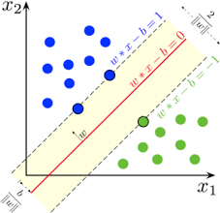
Collaborative-filtering Recommender System using Supervised Learning

Slide 17
Flowchart of KNN based recommender system
User Enrollment Data: Begins with raw user enrollment data.
Create User Vectors: User data is transformed into feature vectors for analysis.
Calculate User Similarity: Similarity between users is computed based on their feature vectors.
Find K Nearest Neighbors: Identifies the most similar users (neighbors) for each user.
Collect Neighbor Courses: Gathers courses enrolled in by the nearest neighbors.
Rank Courses: Ranks the collected courses based on relevance and popularity.
Final Recommendations: Produces a final list of personalized course recommendations for users.
Create User Vectors
Calculate User Similarity
Find K Nearest Neighbors
Collect Neighbor
Courses
User Data
Final Recommendations
Rank Courses

Slide 18
Flowchart of NMF based recommender system
User-Item Matrix: Begins with the raw user-item interaction data.
Data Preprocessing: The data is cleaned and prepared for analysis.
Matrix Normalization: Normalizes the user-item matrix to ensure consistent scaling.
Non-negative Matrix Factorization (NMF): Decomposes the normalized matrix into two latent factor matrices.
User Matrix W: Represents user latent features.
Item Matrix H: Represents item latent features.
User Latent Features: Extracts latent features for users from matrix W.
Item Latent Features: Extracts latent features for items from matrix H.
Matrix Multiplication: Combines user and item latent features to reconstruct the user-item matrix.
Reconstructed Matrix: Generates a refined user-item interaction matrix with predicted preferences.
Top-N Recommendations: Produces the final list of top-N personalized recommendations for users.
Data
Preprocessing
Matrix Normalization
Non-negative Matrix Factorization
User Matrix W User Latent Features
Item Matrix H Item Latent Features
Matrix Multiplication
User-Item Matrix
Top-N Recommendations
Reconstructed
Matrix

Slide 19
Flowchart of Neural Network Embedding based recommender system
User ID: Begins with the unique identifier for each user.
User Embedding: Transforms the user ID into a dense vector representation (embedding) for analysis.
Item ID: Begins with the unique identifier for each item.
Item Embedding: Transforms the item ID into a dense vector representation (embedding) for analysis.
Neural Network: Combines user and item embeddings as input to a neural network for learning interactions.
Prediction Score: Generates a score representing the likelihood of user-item interaction.
Recommendations: Produces a final list of personalized recommendations based on the prediction scores.
User ID User Embedding
Item ID Item Embedding
Neural Network
Prediction Score
Recommendations

Slide 20
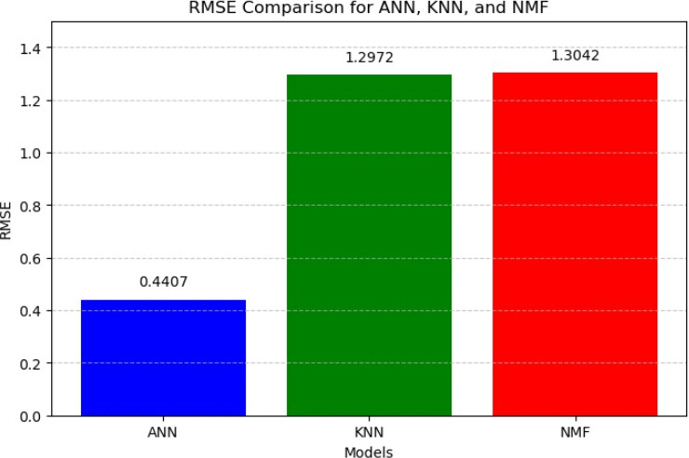
Compare the performance of collaborative- filtering models
The bar chart compares the RMSE values for three recommendation models: ANN, KNN, and NMF.
ANN achieves the lowest RMSE, demonstrating superior accuracy in predicting user preferences compared to KNN and NMF, which show similar performance.
This highlights ANN's effectiveness in generating more precise recommendations over traditional methods.

Slide 21
Conclusions
Exploratory data analysis was conducted on the user-item interaction datasets.
Content-based recommendation systems were implemented using unsupervised models.
Supervised learning methods were ultimately employed to develop collaborative filtering-based recommender systems.
For the content-based systems, adjusting and optimizing the similarity threshold was achieved by evaluating the average number of recommendations per user. An average of approximately 20 recommendations per user was found to be optimal.
Among the collaborative filtering-based systems, ANN (Artificial Neural Networks) demonstrated the best performance.
21

Slide 22
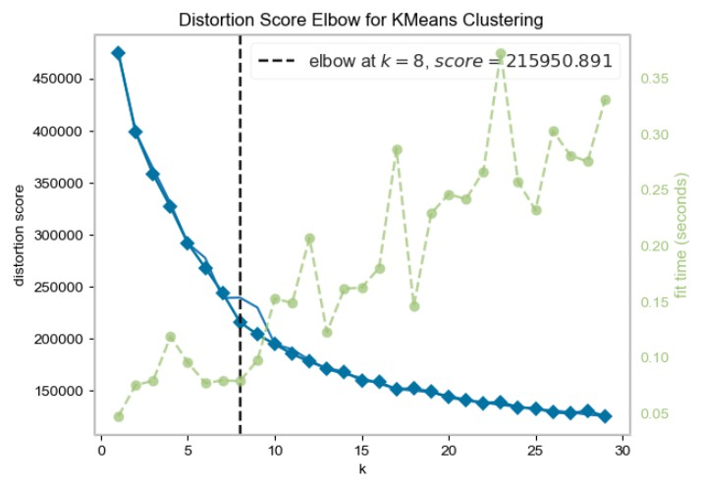
Appendix
22

